Slide 1
Wireless USIM Interface
Solution for phone number sharing between smart phone and watch
Jiacheng Wang
(jiacheng.wang@intel.com)

Slide 2
Use Case: cellular watch
Apple Watch series 3
The freedom of cellular

Slide 3
Problem: phone number sharing
eSIM Inside
SIM Card
Inside
2 SIMs are connected with the same 1 number in operator’s core network server
Same Number
AT&T NumberSync
$30 service + $30 activation
Min. $10/month
China Unicom Trial
One number, Two terminal
Min. RMB 10/month

Slide 4
Solution: wireless USIM interface
The “dumb” SIM tray is replaced by “smart” SIM tray
With a chip inside, the smart tray can get SIM data by wireless interface
No SIM card is required inside smart phone
Share the SIM card inside watch
Replace

Slide 5
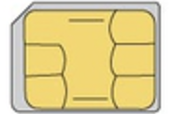
Freedom: Android + iOS
Standard UICC-terminal interface, freedom to Android or iOS
Only 1 SIM card at watch
“Smart” SIM tray at both watch and phone, with a wireless connection
Both phone/tablet and watch share the same SIM card (same number) by wireless USIM interface
Wireless USIM
Wireless USIM
Replace
Wireless USIM
Wireless USIM

Slide 6
Prototype: smart SIM card/tray
Smart SIM tray for iPhone
Smart SIM card
Smart SIM tray for Huawei Watch 2
Smart SIM tray can work in wireless USIM server mode or client mode
Smart SIM card can only work in wireless USIM client mode (no space to put USIM card)

Slide 7
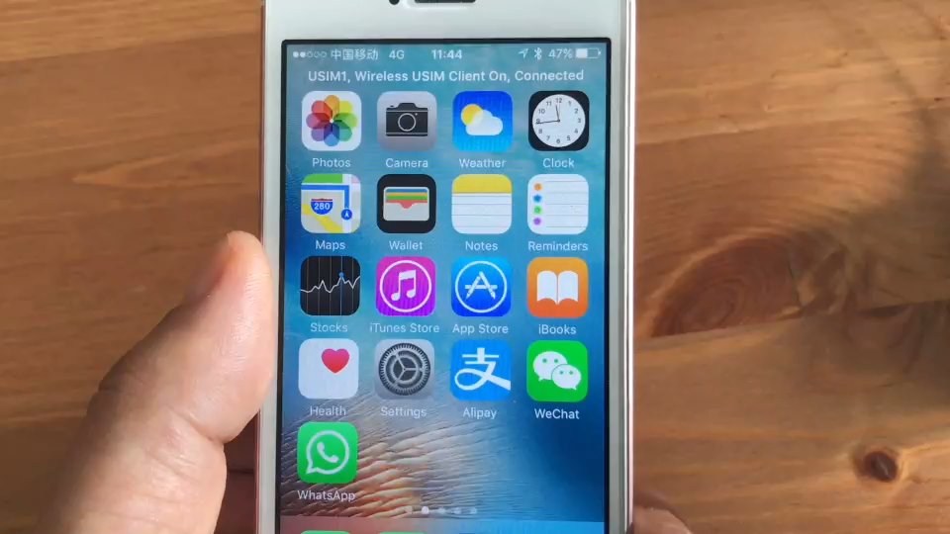
Demo Video : client mode at phone

Slide 8
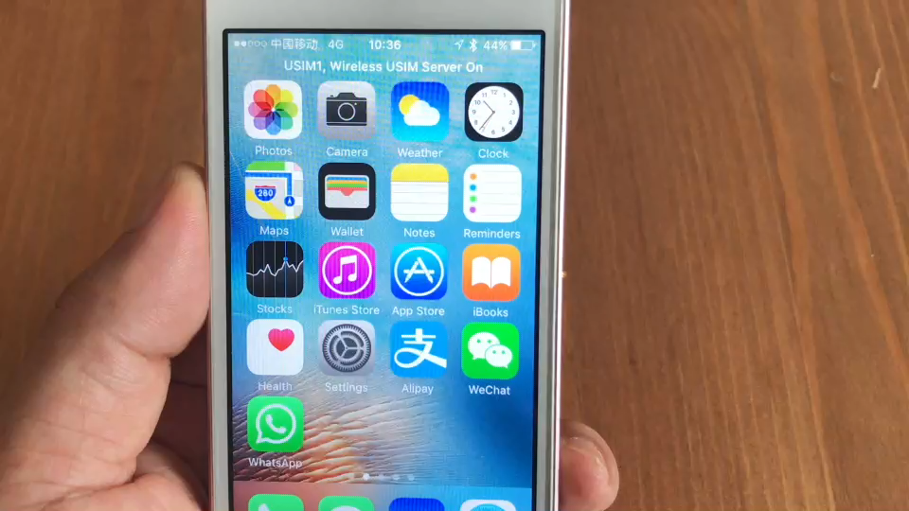
Demo Video : server mode at phone

Slide 9
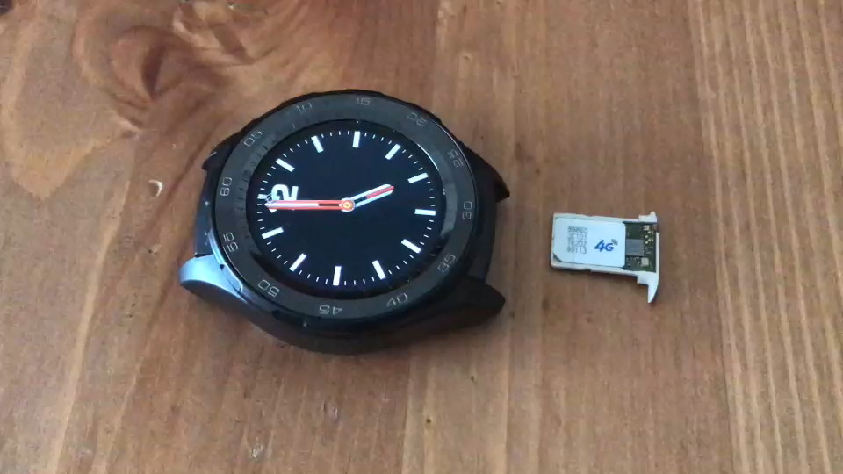
Demo Video : server mode at watch

Slide 10
Benefit: much more
Standard module, no any additional hardware/software required
Only user device, no any operator involved
No user monthly use cost
Wireless USIM interface can be built in phone, no SIM slot required. Better water proof
Multiple user devices share the same USIM card, not only just 2 devices share the same number
Co-existence with eSIM
New concept product, potential large market size
$30 service + $30 activation
Min. $10/mo.
Min. RMB 10/mo.

Slide 11
THANKS

